Slide 1









Idea submission

Slide 2


Team details
Team Leader:
Name: Adithya Anand
Contact: 8050559899
Email:adithyaanand.cs24@bmsce.ac.in
Team Member 2:
Name: Adithya Patil
Contact: 9148950444
Email: adithyapatil.cs24@bmsce.ac.in
Team Member 3:
Name: Aaditya Reddy
Contact:7020185052 Email:aadityanaganath.cs24@bmsce.ac.in

Slide 3


Our solution
The concept of "AI Work Doppelgänger" revolves around using AI to replicate and extend human capabilities in the workplace. It **thinks and acts like you** in routine work situations. This “AI Work Doppelgänger” learns from your decision-making patterns, communication style, and work habits to **handle tasks on your behalf**, reducing cognitive load and freeing you for high-value work.

Slide 4

TECHNICAL APPROACH
Natural Language Processing(NLP)
Task Automation Tools
Email API Integration
Machine Learning and Decision Models
Cloud Computing
Conversational AI Platforms

Slide 5
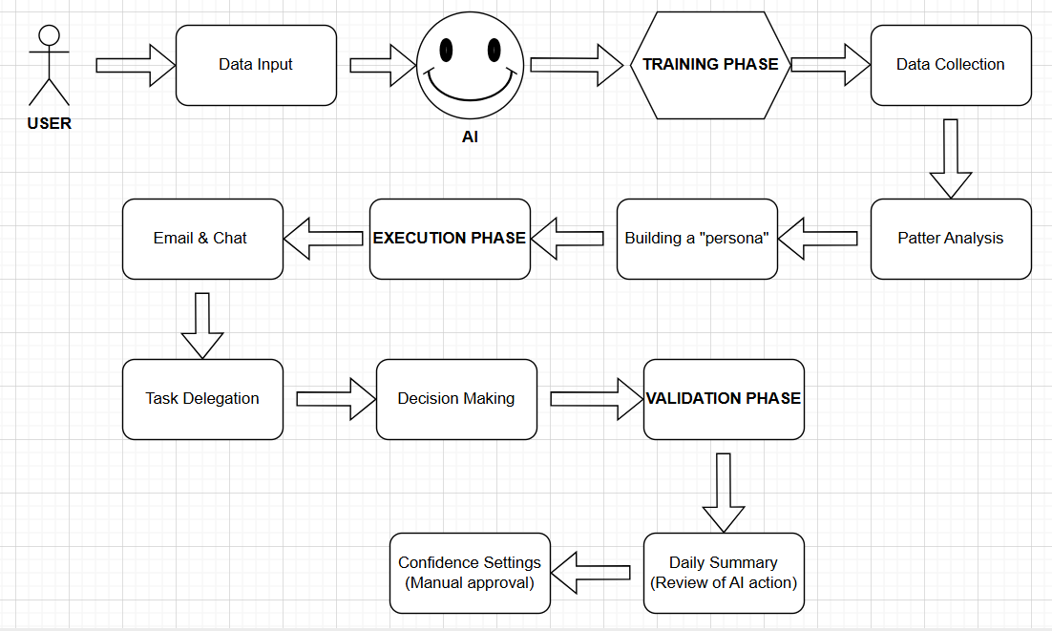
Workflow/pipeline

Slide 6
Feasibility & FUTURE SCOPE
Pros: Increased Productivity
24/7 Availability
Skill Augmentation
Cons:
Job Displacement
Privacy Concerns
Dependance on Technology
FUTURE SCOPE OF THE PROJECT:
Enhanced Personalization
Workforce Augmentation
Democratization of AI
Expansion into New Domians

